Slide 1

A brief overlook into audio and video codecs and ways to improve them using filters
CE487 – Smart Multimedia Systems
Furkan MUDANYALI

Slide 2
Containers
Can hold single or multiple media streams
Some containers exclusively hold one type of stream
Other containers can hold multiple of various media streams

Slide 3
Video containers
MKV (Matroska)
- An open format that can contain virtually any kind of stream
MP4
- Can hold H264, AV1 and VP9 video codecs and AAC, FLAC, Opus and MP3 audio codecs
WEBM
-Can hold AV1, VP8 and VP9 video codecs and Opus and Vorbis audio codecs

Slide 4
Audio containers
FLAC
- The container for the FLAC codec.
M4A
- Can hold AAC or ALAC codec streams.
DSF
- Container for DSD (Direct Stream Digital).

Slide 5
codecs
Compression of media streams
Can be lossy or lossless
Lossy codecs will lower the quality but in turn will have significantly smaller size
Lossless codecs will retain the quality of the source stream at the cost of larger size

Slide 6
Video codecs
H.264 (AVC)
- Block oriented and motion-compensated coding. The most common video codec.
HEVC (H.265)
- Improvement over H264 that supports variable sized blocks
- Delivers around the same quality of H.264 at half the bitrate.
- Not widely adopted due to high licensing fees.

Slide 7
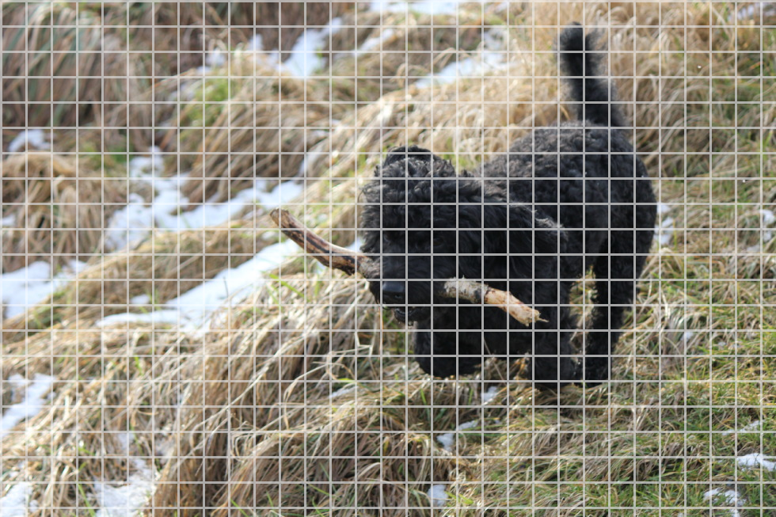
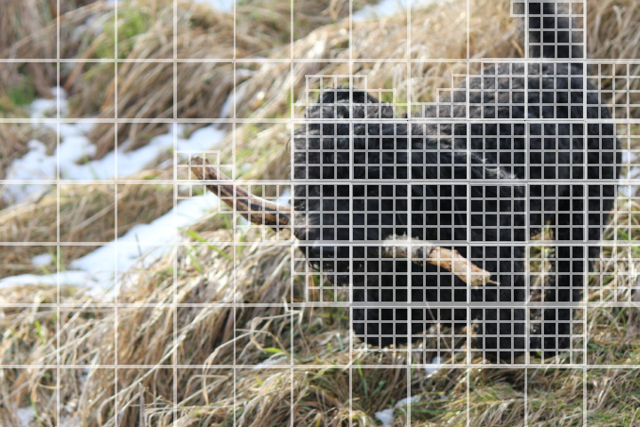
Fixed-SIze blocks vs Variable-Size Blocks

Slide 8
Video codecs
VP8
- Block based codec that shares a lot with H.264
- Aimed to replace the GIF format, not terribly great on higher resolutions.
VP9
- Successor to VP8 and competitor to H.265
- Comparably same performance with H.265 but widely adopted.
AV1
- Successor to VP9.
- 35% to 50% higher data compression compared to VP9.
- Currently the choice for most video streaming services such as YouTube, Netflix and even Facebook with more to come.

Slide 9
Audio CODECS: Lossy STEREO
AAC
- Successor to MP3.
- Widely adopted, standard format for almost all portable devices.
Opus
- Successor to Vorbis, which was an alternative to MP3.
- Performs well even at extremely low bitrates
- Lower latency, preferred by voice call services such as Whatsapp and Signal.

Slide 10
Audio CODECS: Lossless STEREO
FLAC
- Lossless format that can reduce the filesize from 50 to 70% depending on compression.
- Able to decode quickly independent from the compression level.
ALAC
- Lossless format by Apple that is comparable to FLAC in compression.
- Requires around 4 times more CPU power to decode compared to FLAC.
DSD
- Uses delta-sigma modulation compared to pulse-code modulation (PCM) like in conventional audio formats.
- Requires specialized hardware to decode.
- Adopted in mainly Japan.

Slide 11
AUDIO CODECS: SURROUND
AC3
- Lossy format by Dolby Digital that can hold up to 6 channels (5.1) at 640 kbps.
DTS
- Lossy format by Digital Theater Systems that is comparable to AC3.
- Despite being able to reach 1500 kbps, it was mostly encoded in 750 kbps to make room for more audio tracks.
Dolby TrueHD
- Lossless format by Dolby Digital that can hold up to 8 channels (7.1) at 18 mbps.
DSD
- It is also able to hold 6 channels (5.1) at around 20 mbps. Was distributed along with the stereo mixes in SACDs (Super Audio CD).

Slide 12
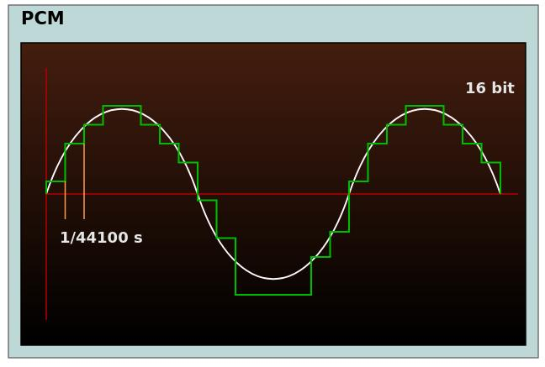
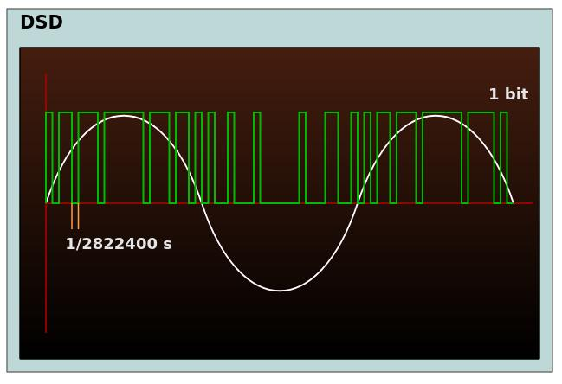
DSD VS. PCM, a Visual Comparison
By Paweł Zdziarski from Wikimedia Commons https://commons.wikimedia.org/wiki/File:PCM-vs-DSD.svg

Slide 13
VIDEO FILTERS
Software components to process the video stream in one way or another.
Deinterlacing
Denoising
Deflicking
Deblocking
Frame Interpolation

Slide 14

INTERLACED vs PROGRESSIVE
Progressive
Interlaced
Peppers by University of Southern California https://sipi.usc.edu/database/database.php?volume=misc&image=13

Slide 15
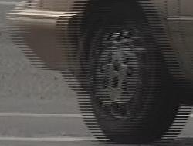
DEINTERLACING
Field Combination
- Weaving
- Blending
Field Extension
- Half Sizing
- Line Doubling
Combing Effect
By Mikus from Wikimedia Commons
https://en.wikipedia.org/wiki/File:Interlaced_video_frame_(car_wheel).jpg

Slide 16
Field Combination: WEAVING
In the PS2 game "Ratchet: Deadlocked", which runs at 60 frames per second, the "combing effect" can clearly be seen.
Used the following script to capture: https://furkanmudanyali.com/blog/codecs/capture.sh
Link to the recording: https://furkanmudanyali.com/blog/codecs/original.mp4

Slide 17
FIELD EXTENSION: Line Doubling
The same PS2 game "Ratchet: Deadlocked" passed through BWDIF and YADIF deinterlacing filters.
YADIF: https://furkanmudanyali.com/blog/codecs/yadif.mp4
ffmpeg –i input.mkv -vf "yadif=mode=0:parity=0:deint=0" yadif.mp4
BWDIF: https://furkanmudanyali.com/blog/codecs/bwdif.mp4
ffmpeg –i input.mkv -vf "bwdif=mode=0:parity=0:deint=0" bwdif.mp4

Slide 18
FRAME INTERPOLATION
Doubles the framerate by blending the 2 adjacent frames and filling the gap.
Minterpolate (Motion Interpolation: Blend): https://furkanmudanyali.com/blog/codecs/minterpolate_basic.mp4 (took 6 minutes to process)
ffmpeg -i input.avi -vf "minterpolate=fps=48:mi_mode=blend" minterpolate_basic.mp4
Minterpolate (Motion Interpolation: Adaptive overlapped block motion compensation with bidirectional motion estimation and variable-size block motion compensation): https://furkanmudanyali.com/blog/codecs/minterpolate_advanced.mp4 (took 4 hours to process)
ffmpeg -i input.avi -vf "minterpolate=fps=48:mi_mode=mci:mc_mode=aobmc:me_mode=bidir:vsbmc=1" minterpolate_advanced.mp4
Big Buck Bunny Short Film by Blender Foundation (CC BY 3.0) https://peach.blender.org

Slide 19
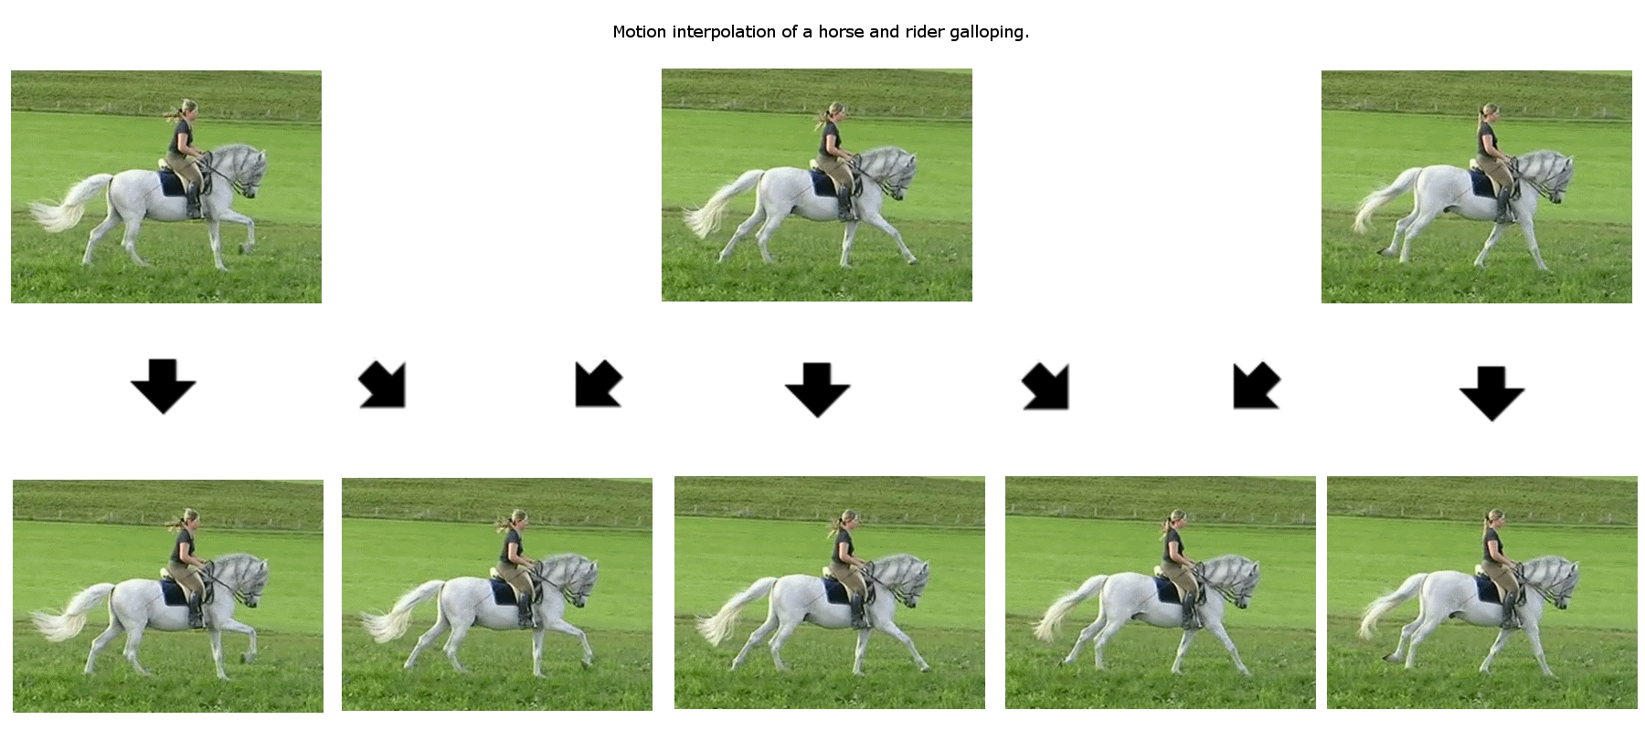
FRAME INTERPOLATION
Frame interpolation example by Waugsberg, Peregrine Fisher and nr1jack from Wikimedia Commons https://commons.wikimedia.org/wiki/File:Motion_interpolation_example.jpg

Slide 20
Any Questions?
Thank you :-)

